Slide 1
MACHINE LEARNING PROJECT
Mayur Shobith
7204324215
www.linkedin.com/in/mayur-shobith-851174146

Slide 2
Problem Statement
Visiting hospitals for regular check-ups it is almost always seen that they encourage people to get special check-ups to identify if they are at risk of heart diseases. Heart diseases have unfortunately become very common. It may be due to various reasons such as lifestyle, work pressure, lack of exercise, etc. In this project, we will be working on predicting the 10-year risk of Coronary Heart Disease (CHD). We are given a set of variables that impact heart diseases. These variables are related to demographic, past, and current medical history.
The dataset is from an ongoing cardiovascular study on residents of the town of Framingham, Massachusetts. The classification goal is to predict whether the patient has a 10-year risk of future coronary heart disease (CHD). The dataset provides the patients’ information. It include over 3390 records and 16 attributes Variables. Each attribute is a potential risk factor. There are both demographic, behavioural, and medical risk factors.

Slide 3
About the data,
The dataset has 3390 observations and 17 features .
The features observed in the dataset are as below,
ID : Identification numbers for records/observations of each Patient
Age : Age of the patient
Education : 1 - Higher Secondary, 2- Graduate, 3 - Post Graduate 4- Doctorate or PHD
Sex : Gender of the Patient
Is_smoking : Tells if a patient is a smoker or not
CigsPerDay : No of cigarettes a person smokes on an average in a day
BP Meds : If the patient is already on BP Medication
PrevalentHyp : Tells if patient has a prevalent Hyper tension
PrevalentStroke : Tells if patient has a prevalent stroke
Diabetes : Tells if patient has diabetes
TotlChol : Gives the total Cholesterol levels of the patient
SysBP : Gives the readings of Systolic BP of the patient
DiaBP : Gives the readings of Diastolic BP of the patient
BMI : Gives the records of Body Mass Index of the patient
Heat Rate : Gives readings of Heart Rate of the patient
Glucose : Gives readings of Glucose levels of the patient
Ten-year CHD : Target variable which tells if a patient has risk of CHD in 10 Years

Slide 4
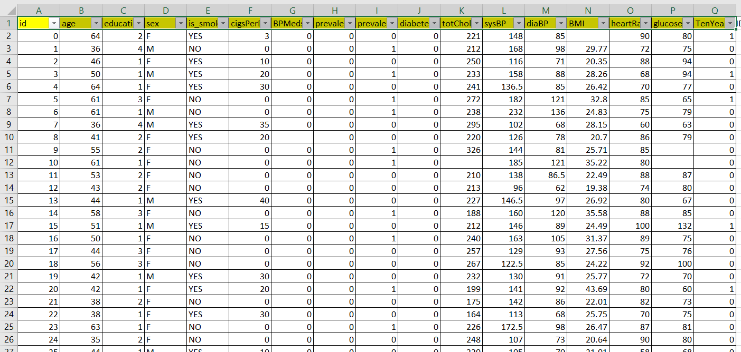
Overview of the dataset :

Slide 5
Steps followed for the Model Development
Understanding the problem statement
Data Wrangling
Exploratory Data Analysis
Model development
Model Performance metrics and Evaluation

Slide 6
Understanding the problem statement:
The task is to predict if the patient has a ten year risk of future Coronary Heart disease
The target feature is binary class with 0- No risk of CHD and class 1 – Risk of CHD
The problem has a target variable and needs prediction of either classes ,
Hence the problem is a Supervised , classification task

Slide 7
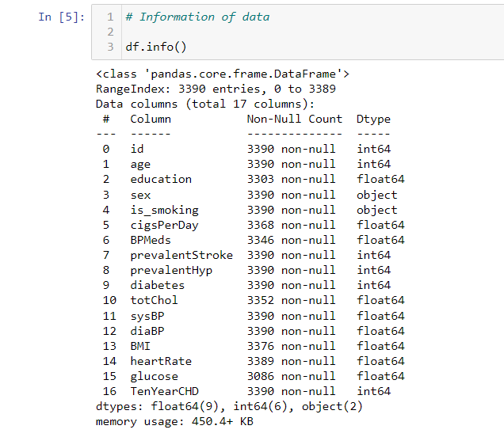
Data Gathering :
The data set has been provided as input in CSV format
The initial steps involve importing the necessary packages in the python notebook and loading the data set
Data wrangling and Data cleaning :
This step involves understanding the raw data set,
Data cleaning refers to removing unwanted or undesirable data to make the data ready for learning activity
Data wrangling refers to the transformation of the raw data into a desirable format so that data is improved and is in the desirable format
Finding the data shape and information on the data to know what types the given variables are
Data set shape : (3390, 17)

Slide 8
Exploratory data Analysis :
The process which incorporates statistical techniques to describe or understand the underlying pattern or trend in the data set
It is also used to understand and compare the data whether it is as is the raw data without any assumptions being made and also to summarize and describe the characteristics of the data set using statistical and visualization approach
In this project there is and attempt made to perform EDA and Data wrangling hand in hand to obtain desirable information and improved data for the model development
To begin with the data preprocessing, the following steps have been performed
Identify the missing data using isnull().sum() for each feature in the data set
Below is the table that tells us the percentage of the missing data
Features | % of missing value
Education | 2.566
CigsPerDay | 0.648
BPMeds | 1.297
totChol | 1.12
BMI | 0.4129
HeartRate | 0.02
Glucose | 8.967
As an empirical rule , any feature with more than 25% missing data can be dropped from dataset
But here missing values are less than the threshold and hence missing data shall be treated

Slide 9
Handling Missing data :
‘Education’ feature: The data type of the feature is categorical and hence we find the most frequent value of the feature and replace the missing value with that value,
Statistically, the most frequent value of the feature is ‘Mode’ of the feature
In this case, the mode value is ‘1.0’ which corresponds to ‘Higher Secondary’
Hence missing value is replaced with ‘1.0’
‘ BP Meds ' feature: This is a categorical variable which tells if patient is on medication or not ,
Hence going by the similar mode approach, all the missing values are replaced by ‘0.0
‘’totChol’ feature: This feature gives total Cholesterol levels of a patient and is a continuous variable
Hence going by median approach, all the missing values are replaced by234.00
‘ BMI’ feature: This feature gives the BMI of the patient and is a continuous variable
Hence going median approach all the missing values are replaced by 25.38
‘ Heart Rate’ feature: This feature gives the reading of heart rate of a patient and is a continuous variable
Hence going by the median approach, all the missing values are replaced by 75.00
‘ Glucose ’ feature: This feature gives the reading of glucose levels of a patient and is a continuous variable
Hence going by the median approach, all the missing values are replaced by 78.00

Slide 10
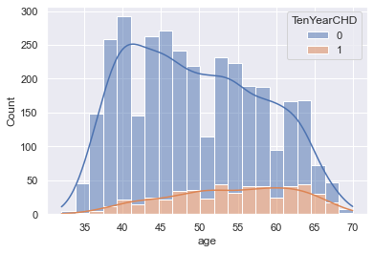
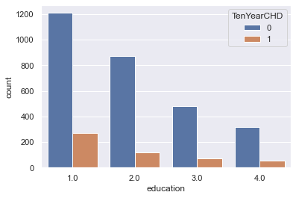
Exploratory Data Analysis
Age
Education Background
We can observe that the risk of CHD is found in patients from starting from age group 40-70
It is observed that patients who have a background of Higher secondary education have risk of CHD , However this is the observation made and in a general sense , education might not actually contribute to predict if a patient has CHD

Slide 11
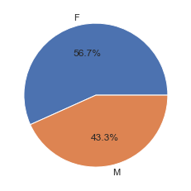
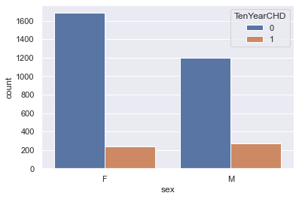
Sex
TenYearCHD | 0 | 1
sex
F | 1684 | 239
M | 1195 | 272
There are more female patients recoded in the data set
Of the sample chosen , More male are showing the risk of CHD than women

Slide 12
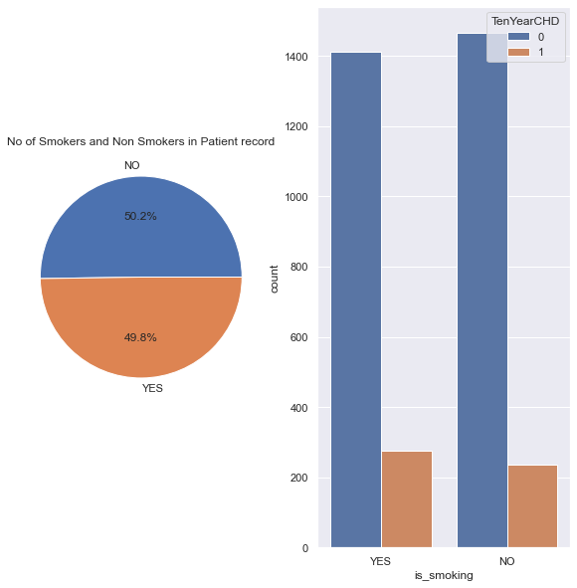
Smoking and CHD Risk
TenYearCHD | 0 | 1
is_smoking
NO | 1467 | 236
YES | 1412 | 275
The data shows almost equal number of smokers and non smokers , but when compared with reference to CHD risk,
People smoking and with CHD risk are more than people not smoking and with risk of CHD

Slide 13
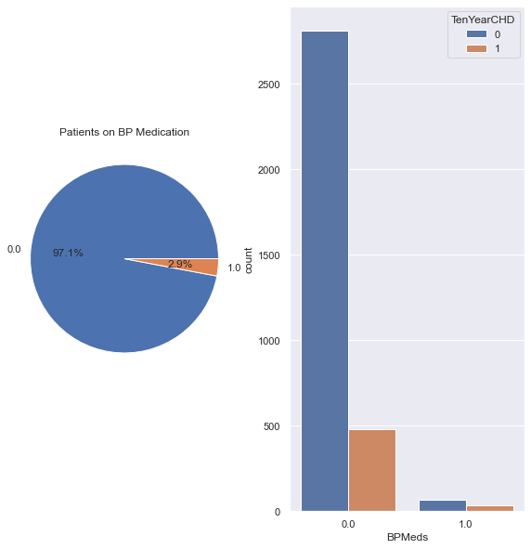
BP Meds and CHD Risk
TenYearCHD | 0 | 1
BPMeds
0.0 | 2812 | 478
1.0 | 67 | 33
It is evident that most patients are not under any type of BP Medication
* Also We see no such relation which shows people under BP Medication are prone to CHD Risk

Slide 14
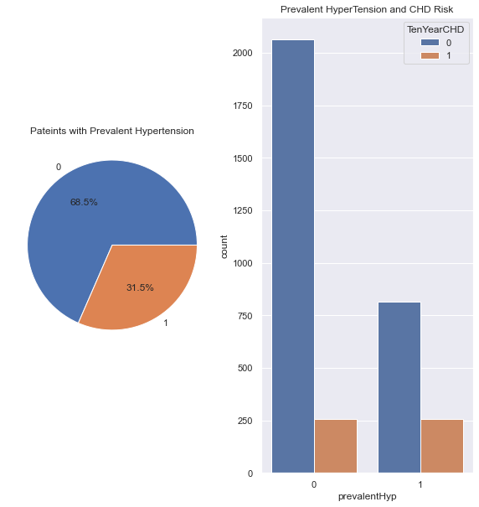
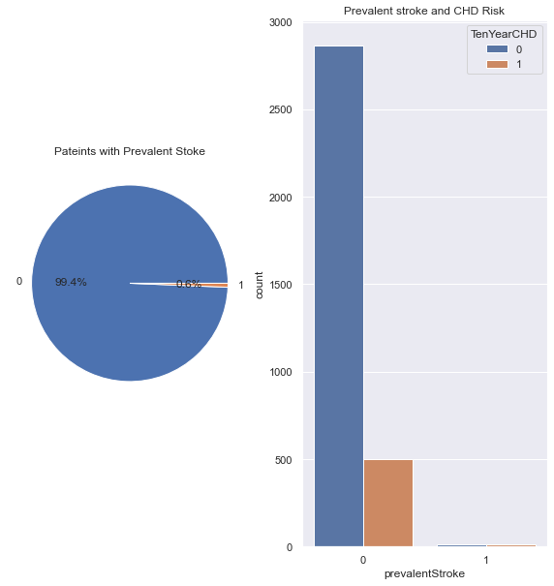
Prevalent stroke condition and CHD Risk
Prevalent Hyper tension condition and CHD Risk
* It is evident that most patients are not exhibiting prevalent stroke conditions
* Also We see no such relation which shows people with prevalent are prone to CHD Risk
* It is observed that More patients do not have any condition of prevalent Hypertension
* However when we compare the chances of CHD , almost same amount of patients with / without Hypertension have CHD risk,

Slide 15
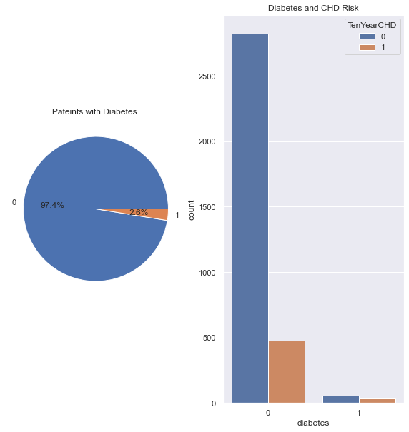
Diabetic condition and CHD Risk
TenYearCHD | 0 | 1
diabetes
0 | 2825 | 478
1 | 54 | 33
It is evident that most patients are not diabetic
Also We see no such relation which shows people who are diabetic are prone to CHD Risk

Slide 16
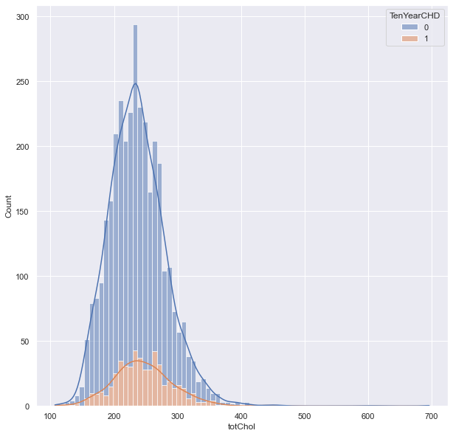
Cholesterol levels and CHD Risk
We can observe that patients with Cholesterols levels around 200-300 have chances of CHD risk

Slide 17
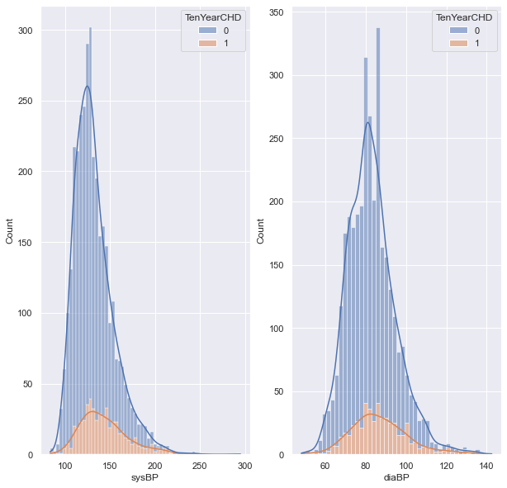
Blood pressure levels and CHD Risk
* We can observe patients having systolic bp in the range 120 -200 and diastolic BP 70-100 have chances of CHD Risk
* This also justifies if a person is having High Blood pressure or not because the normal level is considered to be 120mm/80mm Hg

Slide 18
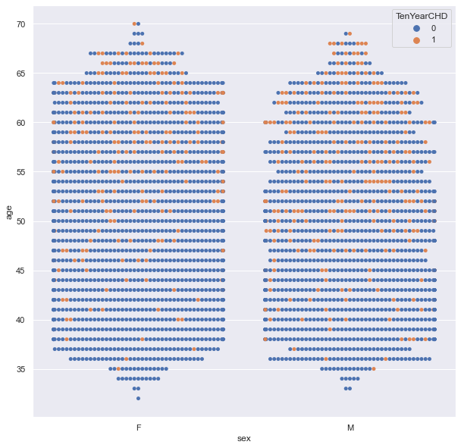
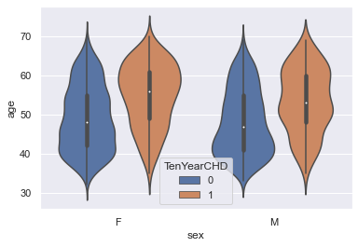
Age , Gender and CHD Risk
* We can observe that more Female patients around the age group 60 have risk of CHD
* Where as Male patients around the age group 45-60 have risk of CHD

Slide 19
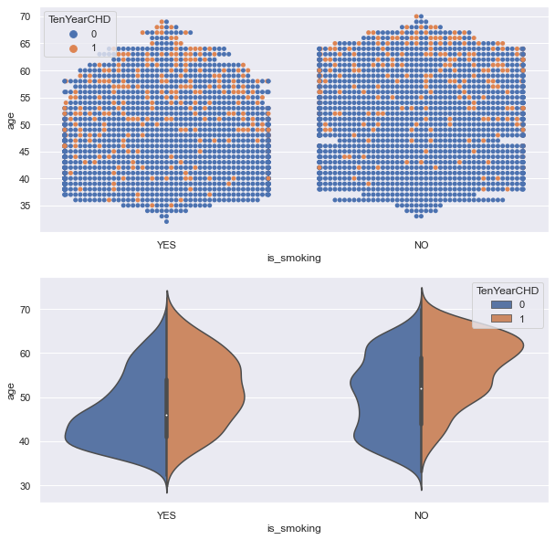
Smokers / Non Smokers , their age and risk of CHD
Most number of smokers belong to age group 40-60
Smokers within age group 40 have less CHD Risk where as smokers belonging to age group 45-60 are prone to CHD Risk
Non Smokers from age group around 60 are prone to CHD risk
We can infer that smoking can be a factor that might lead to CHD risk at early ages than when compared to non smoking

Slide 20
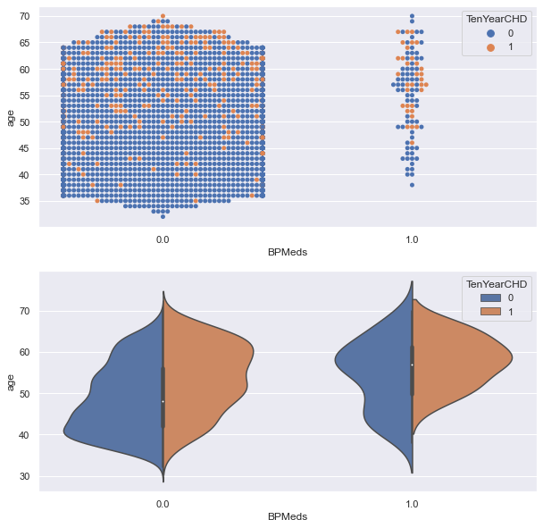
Age wise stats who are on BP Medication
Most patients from age group around 55-60 are under BP Medication
People of age group around 60 under BP Medication have shown risk of CHD
At times medicines of high blood pressure can cause chest pain or irregular heart beats , this also might account to the risk of CHD

Slide 21
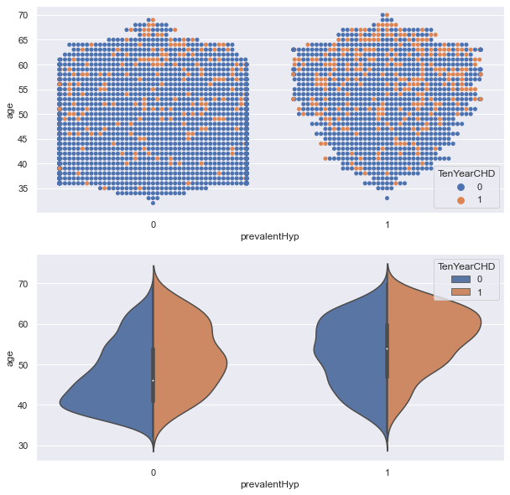
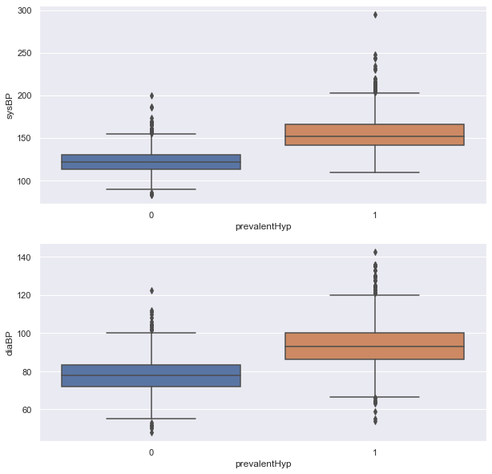
Age factor and Prevalent Hypertension
Hyper tension conditions determined basis blood pressure levels
We can observe that patients belonging to age group around 55-65 with a prevalent hypertension are prone to risk of CHD
We can observe that prevalent conditions are declared basis BP levels where systolic BP is found more than 130 ,
diastolic BP is more than 70

Slide 22
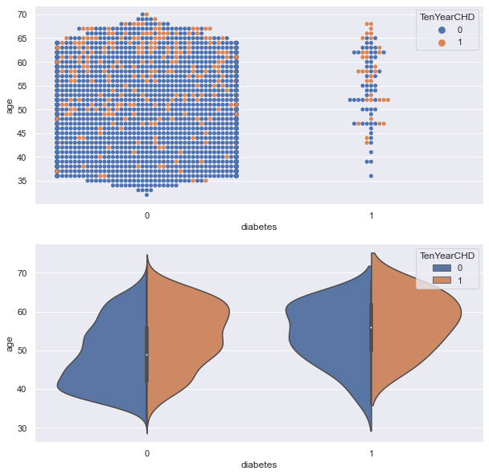
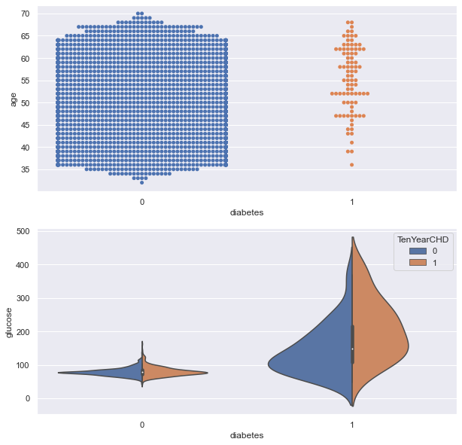
Age factor and Diabetic conditions – Effect on CHD Risk
Patients around age 50-60 are prone to diabetes , These Patients with diabetes are prone to CHD Risk
We observe that patient Glucose level more than 120 to 300 are diagnosed with Diabetes
These patients are probe to CHD Risk than with lower/ normal glucose levels

Slide 23
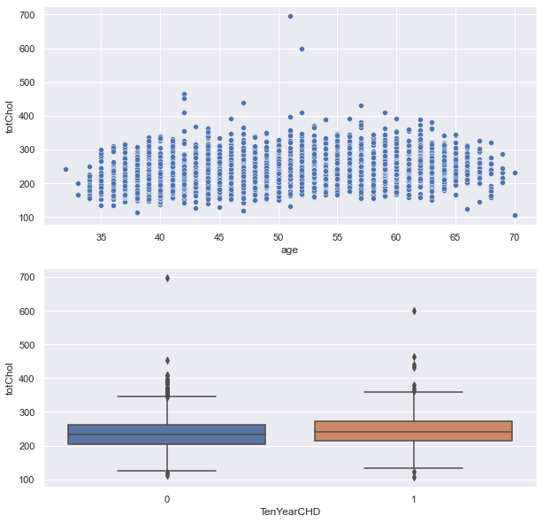
Age factor and Cholesterol levels – Effect on CHD Risk
Cholesterol levels may vary according to age , however we can see risk of CHD for patients with cholesterol levels of 200-300

Slide 24
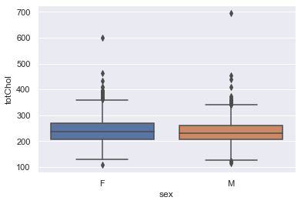
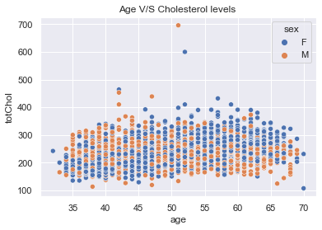
We can see elevated cholesterol levels in Male as age increases ,
However we can observe elevated cholesterol levels in Females in age of 55-60 and beyond

Slide 25
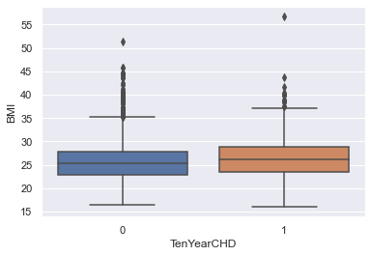
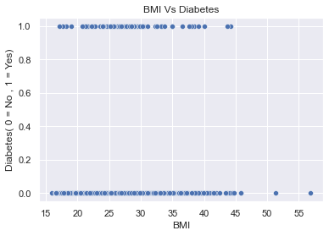
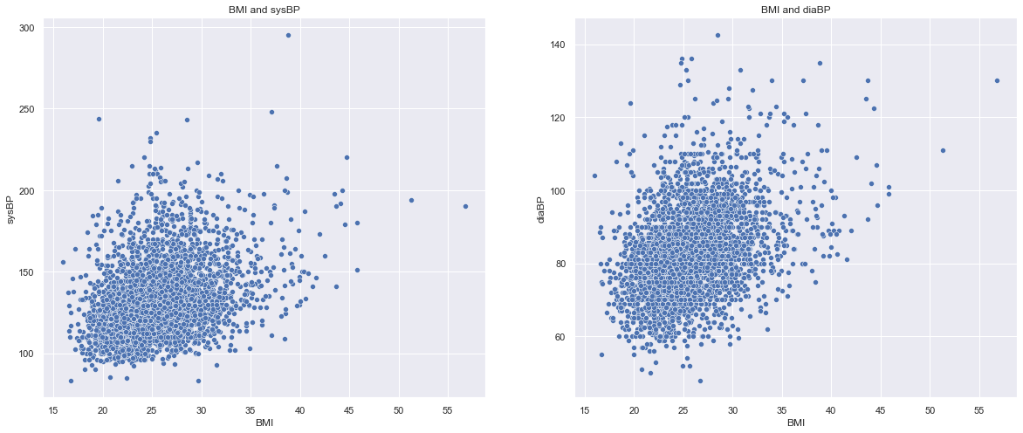
BMI and its effect on diabetes and Blood pressure

Slide 26
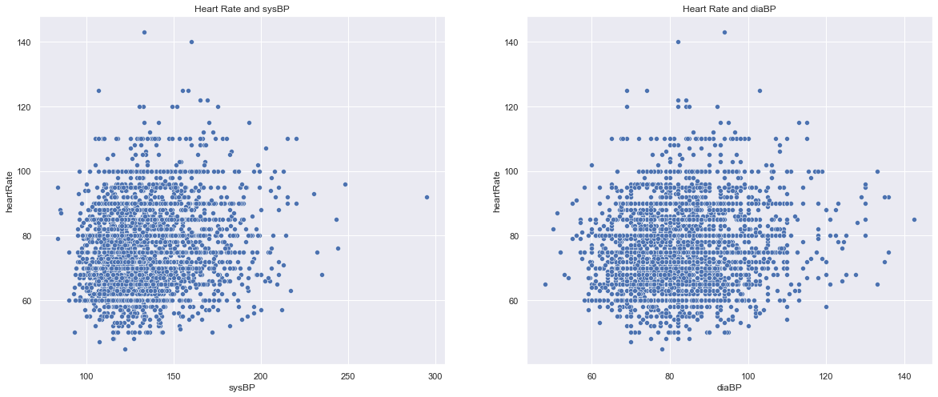
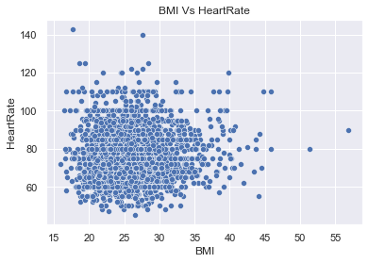
Increased BMI or BMI than nominal levels simply mean over weigh or obesity
There is no such linear relationships with BMI and Diabetes , But we can see a partial pattern where there are chances of Diabetes with an increased BMI
Increased BMI would also have its effect on blood pressure
These elevated levels of Blood pressure and diabetes might effect the coronary conditions and hence would be prone to CHD risk
We can observe that hear rate not necessarily would increase with increased BMI , However there might be other factors it might be elevated along with other conditions such as BP , Glucose with elevated BMI
We can also observe a partial trend where elevated heart rates might result in elevated blood pressure , however hear rate and BP do not increase at same rate

Slide 27
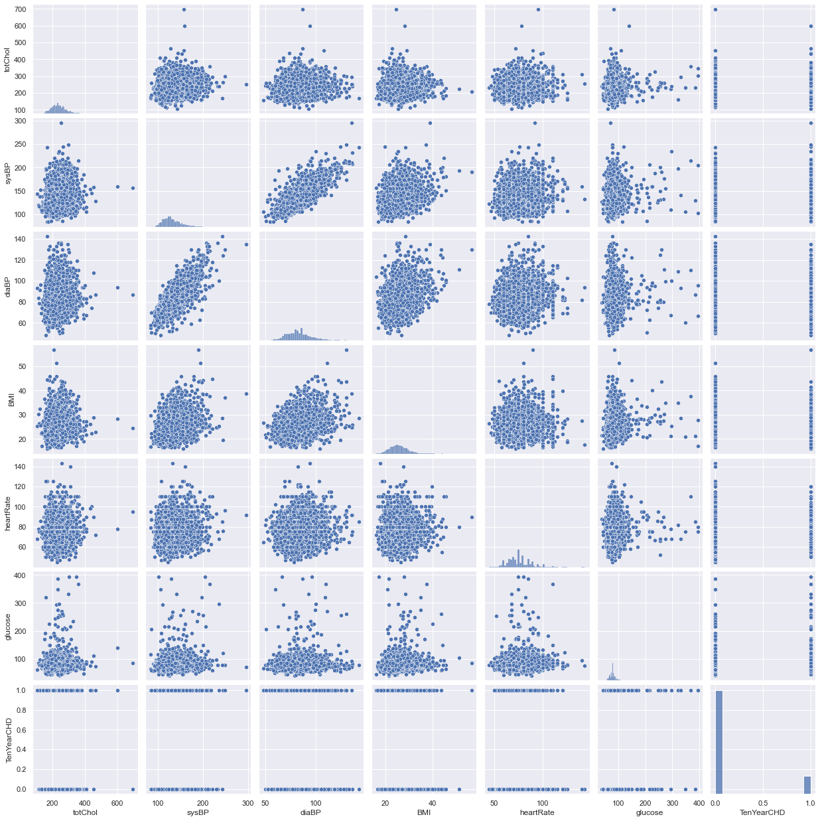

Slide 28
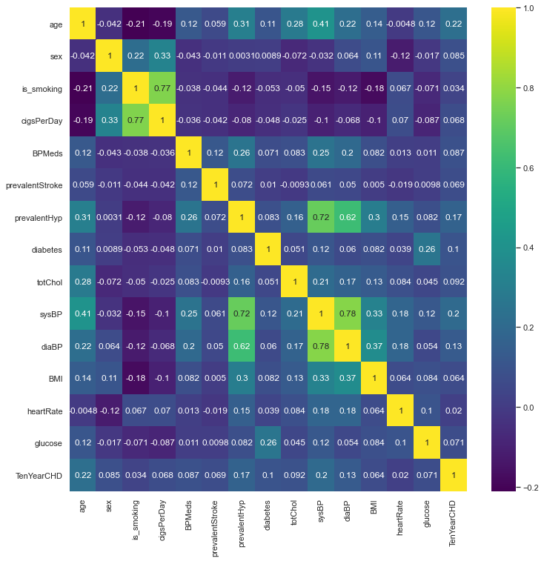
CORRELATION MATRIX
We can see that Systolic BP and diastolic BP are correlated strongly with Coeff of 0.78
Also Number of cigarettes per day with is_smoking is related with a Coeff of 0.77
Hence removing features ' diastolic BP ' and no of cigarettes Per day

Slide 29
CHD can be expected at even early age group of 35-40 , This might be due the poor lifestyle , obese and at cases prevailing medical conditions of BP and Diabetes
Dataset has almost equal proportion of Male and Female , However it is observed that Gender might not be a strong factor to know whether a patient has CHD risk or not
But , It is observed Men around age group 45-60 have risk of CHD and in comparison women around age group 60 have CHD Risk
Smoking can be a factor that can lead to CHD , because we have seen as age grows with smoking habit , those observations were prone to CHD
Patients with prevailing Hypertension are prone to CHD than patients without a prevailing condition
Patients are said to be hypertensive when their Systolic BP is beyond 130 and diastolic BP is beyond 90
Patients exhibiting Sys BP 120-200 and diastolic BP 70 – 100 were also diagnosed with CHD Risk
Patients with Glucose level 120 – 300 were diagnosed with diabetes and these were also proven with risk of CHD
It is also observed with a partial trend that as BMI is increase intern , BP , Glucose levels and Cholesterol levels are also elevated . Such conditions might be prone to CHD risk in future
We can infer that , it is not a single factor that strongly decides the CHD risk ,
These Vitals measured and recorded are interlinked , and variation amongst all happen to contribute to CHD ,
The variations in these Vitals can also be due to the behavioural aspects such as smoking and demographic attributes such as Age.

Slide 30
DATA PREPROCESSING (CONTD..)
Label Encoding :
Since the machine should be inputted with the binary data format, all the categorical variables need to be converted to binary format
This can be done with the help of a Label Encoder
For this context Label encoder has been used since all the categorical variable had 2 classes
Data Split :
The data will be split into two data frames
X = Data frame of independent variable
Y = Data frame of the target variable
Feature Scaling :
For distance-based ML algorithms, feature scaling is important
This is because the distance between 2 points and their dependent features should be comparable by scale
For the project a standard scaler() has been used

Slide 31
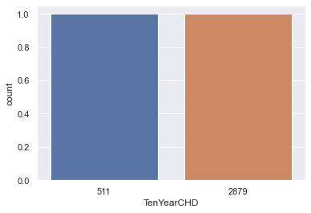
Imbalance Data Check : We have imbalance data because minority class TenYearCHD = 1 i.e 511 * 2 = 1022 is still less than majority class TenYearCHD = 1 which is 2879 Hence imbalance data needs to be handled / balanced
Random Over Sampler was used to handle the imbalance
MODEL BUILDING :
Train_test_split :
The data set is split into training data and testing data at ratio of 75% training data and 25% as the test data
MODELS TRAINED
Logistic Regression
Decision Tree
Random Forest
K-Nearest neighbours
Support Vector Machine
Evaluation and Performance Metrics
Accuracy
Classification Report
Confusion Matrix

Slide 32
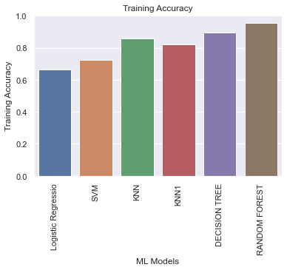
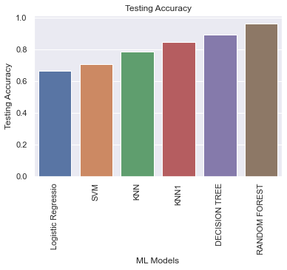
Evaluation Metrics : Accuracy for trained models as below
Sl no | ML Models | Training Accuracy | Testing Accuracy
0 | Logistic Regression | 0.664891153 | 0.666666667
1 | SVM | 0.723946271 | 0.70625
2 | KNN | 0.857804539 | 0.788194444
3 | KNN1 | 0.823070809 | 0.848611111
4 | DECISION TREE | 0.894400941 | 0.896527778
5 | RANDOM FOREST | 0.956695776 | 0.966666667
From the tabular data , we can see that
Three models which are giving good results are
* Random Forest
* Decision Tree
* Knn with neighbors = 3

Slide 33
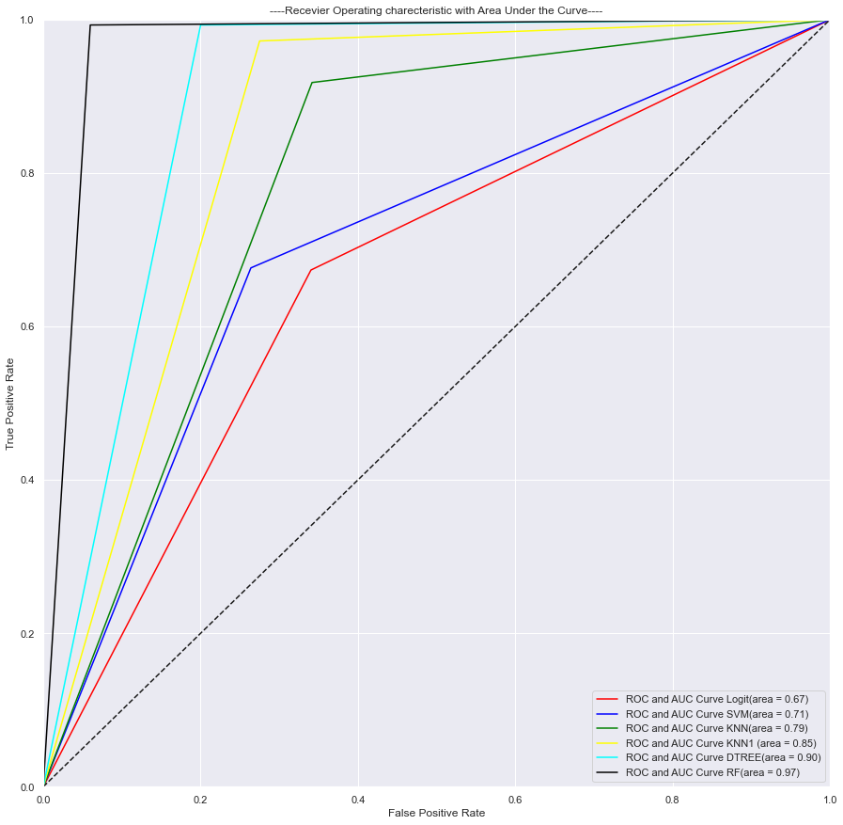
ROC_CURVE FOR VARIOUS MODELS
ROC_Score is good for models Random Forest ,
Decision Tree ,
K nearest neighbors ( k = 3)

Slide 34
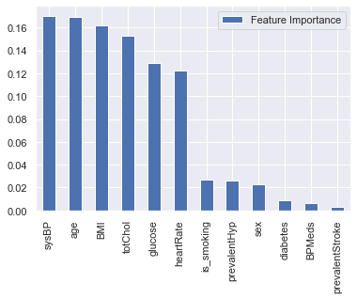
Feature Importance as found from Random Forest
We can observe that below factors determine whether a Patient has risk for CHD
* Blood pressure
* Age
* BMI
* Cholesterol levels
* Glucose levels
* Varying Heart Rates

Slide 35
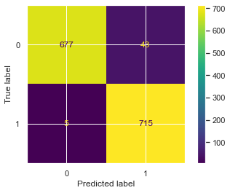
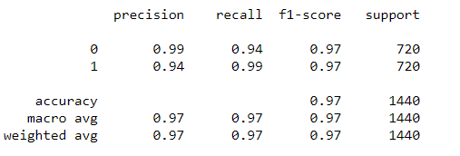
Random Forest Results :
Accuracy :
Training Accuracy 0.956695776402853
Testing Accuracy 0.9666666666666667
FPR : [0. 0.05972222 1. ]
TPR : [0. 0.99305556 1. ]
ROC_AUC : 0.9666666666666667
Per Confusion matrix
Patients without risk and predicted no risk = 677
Patients with risk and predicted with risk = 715
Patients without risk but predicted as risk = 43
Patients with risk but predicted as no risk = 5
Classification Report :
Predicted | 0 | 1 | All
Actual
0 | 677 | 43 | 720
1 | 5 | 715 | 720
All | 682 | 758 | 1440

Slide 36
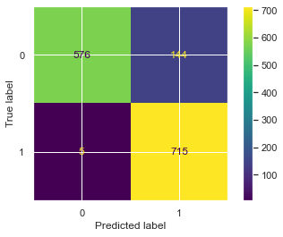
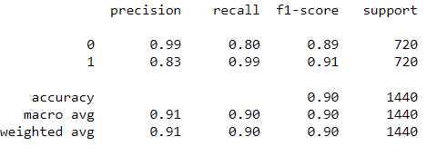
Decision Tree Results :
Accuracy :
Training Accuracy 0.894400940964166
Testing Accuracy 0.8965277777777778
FPR : [0. 0.2 1. ]
TPR : [0. 0.99305556 1. ]
ROC_AUC : 0.8965277777777778
Per Confusion matrix
Patients without risk and predicted no risk = 576
Patients with risk and predicted with risk = 715
Patients without risk but predicted as risk = 144
Patients with risk but predicted as no risk = 5
Classification Report :
Predicted | 0 | 1 | All
Actual
0 | 576 | 144 | 720
1 | 5 | 715 | 720
All | 581 | 859 | 1440

Slide 37
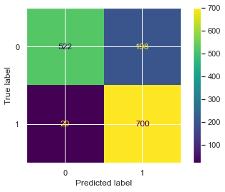
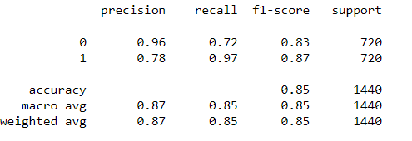
KNN(k = 3) Results :
Accuracy :
Training Accuracy 0.8230708086276532
Testing Accuracy 0.8486111111111111
FPR : [0. 0.275 1. ]
TPR : [0. 0.97222222 1. ]
ROC_AUC : 0.848611111111111
Per Confusion matrix
Patients without risk and predicted no risk = 522
Patients with risk and predicted with risk = 898
Patients without risk but predicted as risk = 198
Patients with risk but predicted as no risk = 20
Classification Report :
Predicted | 0 | 1 | All
Actual
0 | 522 | 198 | 720
1 | 20 | 700 | 720
All | 542 | 898 | 1440

Slide 38
CONCLUSION :
Of the three models , Random Forest can be chosen since it is yielding good results when compare to other models in terms of all
evaluation metrics below
* Accuracy
* F1-Score
* Precision and Recall
* Area under curve characteristics

Slide 39
THANK YOU

